Slide 1


Slide 2

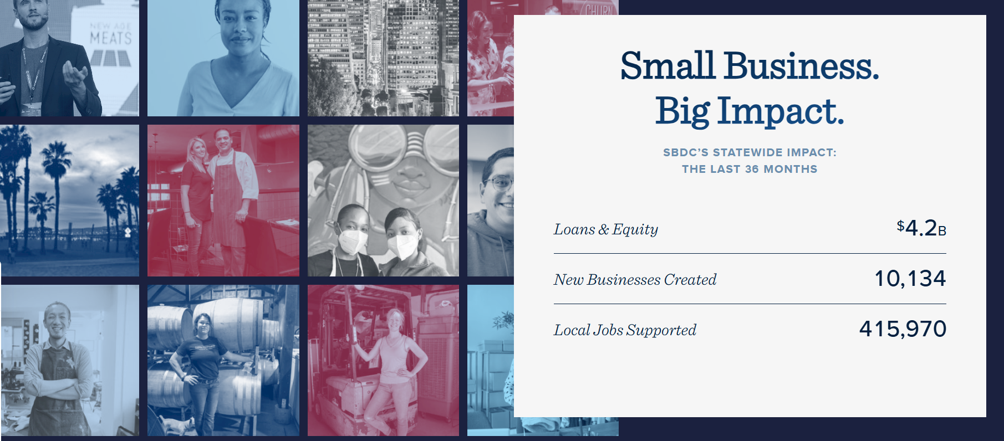
CaliforniaSBDC.org | 2

Slide 3

CA SBDC
2024-2025 Activities and Outcomes
Activity
Total Clients Served | 51,322
Total Consulting Hours | 157,003
Total Training Events | 3,477
Outcomes
Business Starts | 1,618
Capital Infusion – Number of | 3843
Capital Infusion – Dollar Amount | $1,106,565,581
Increase in Sales | $1,090,672,983
Jobs Created | 19,752
CaliforniaSBDC.org | 3

Slide 4
California
for All
Small Business
Expand investment in TAP and CIP funding
Empower capital access
Innovate (AI, supply chains)
Enable scaling

Slide 5

Thank you for supporting California’s 4.2 million small businesses

Slide 6
Capital for Small Business
Tech and Innovation
California’s Small Manufacturers
Procurement Opportunities
Business Growth
2026
CA SBDC Priorities
CaliforniaSBDC.org | 6

Slide 7

Mark your Calendars
Sacramento CA SBDC Visits
March 18 & 19
May 13 & 14
CaliforniaSBDC.org | 7

Slide 8

CaliforniaSBDC.org | 8

