Slide 1

Governor’s 2025 Reorganization:
Looking Forward

Slide 2









Business and Consumer Services Agency
Alcoholic Beverage Control Appeals Board
Cannabis Control Appeals Panel
California Horse Racing Board
Department of Cannabis Control
Department of Consumer Affairs
Department of Financial Protection and Innovation
Department of Real Estate
California Housing and Homelessness Agency
California Interagency Council on Homelessness
California Housing Finance Agency
Civil Rights Department
Housing Development and Finance Committee
Department of Housing and Community Development
BCSA & CHHA

Slide 3
Implementation Review:
Implementation workgroups created & working
Fiscal and Administrative Infrastructure
Operational plans for smooth transition
Robust engagement with stakeholders
Active recruitment & Onboarding
HDFC:
  Draft guidelines
  Draft Charter

Slide 4
Every additional funding source adds an additional $20,000 and 4 months per unit.
Housing Development & Finance Committee
&
Housing Proposals
Lowering Construction costs
Speeding up timelines
Removing unnecessary complexity
A CHP analysis estimates this proposal can save $40,000 per unit and approximately $439 million in savings per year.

Slide 5
Alignment with CHHA & AB 519 Feedback
GOALS & TRACKING
PORTFOLIO MANAGEMENT & COMPLIANCE
Speed of execution
Reducing costs
Predictability and accountability
Equitable allocation of resources
Income targeting or other public benefits
Ongoing engagement with partners
Cross-training and capacity building
Focus HCD Activity on repositioning and preservation
Reform the negative points policy
Amend policies affecting sponsor distributions and sponsor loans to allow for reimbursement
Consider a portfolio wide approach in which cash flow from one project could be used to assist other projects
NEW FINANCING TOOLS
UNDERWRITING & CLOSING
State provided construction financing
Funding for ownership housing
Refinancing products for permanent supportive housing
A revolving loan fund product
Capital to support acquisitions
Allowing for use of portfolio equity
Clarify roles and authority
Streamline closing process
Standardize documents
Increase transparency

Slide 6
Streamlining
California’s Housing
Finance Process
Housing Development and Finance Committee

Slide 7
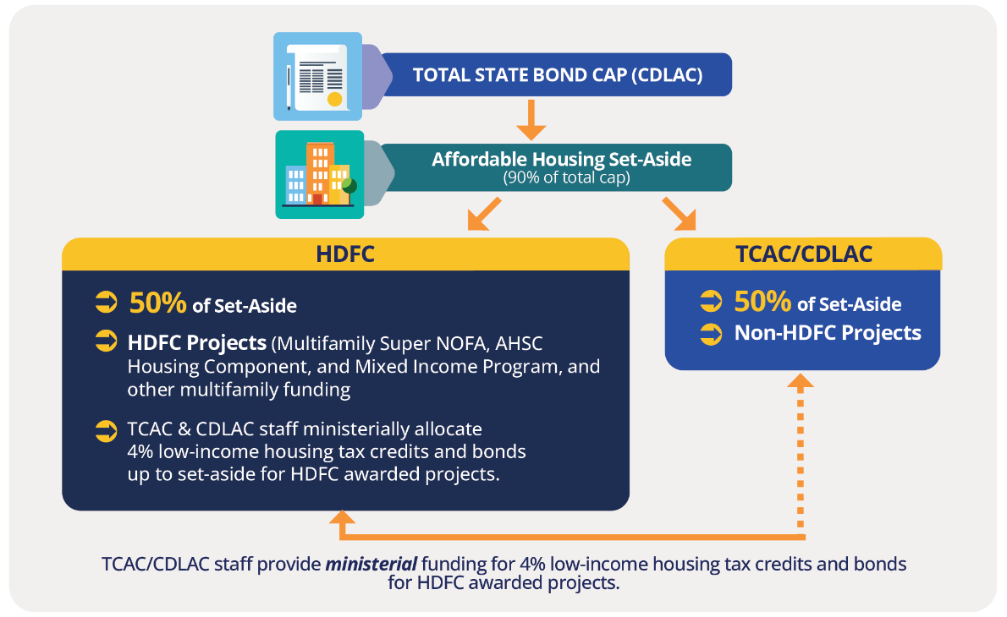
Governor’s budget proposal

Slide 8
So why now?
Two big changes last year:
Creating the Housing Development and Finance Committee
Increased bond capacity from a federal change to the private activity bonds (PABs) financed-by test, dropping the previous 50% requirement to 25%.

Slide 9

We know Time is Money for Affordable Housing Projects
Housing projects need a variety of funding sources, each with different timelines and application requirements. This adds years to a project’s timeline, with unsuccessful applications adding even more time. The uncertainty and delays ultimately increase the cost of building housing.

Slide 10

California’s housing finance system today:
Projects seeking state funding
Affordable Housing Project Capital Stack* Example
Before requesting state funding, developers must first secure non‑state funding (e.g., local support, private investments, etc.).
State Subsidies
HCD administers the Multifamily SuperNOFA (MFSN) application,
which includes MHP, Serna, IIG and VHHP.
CalHFA administers the Mixed-Income Program (MIP) application.
SGC administers the Affordable Housing and Sustainable Communities (AHSC) application.
State-administered Private Activity Bonds / Tax Credits
CDLAC administers private activity bonds and TCAC administers 4% tax credits. Because projects must begin construction within 180 days, this application is typically the final step.
Non-state Investments
State Subsidies
State administered Private Activity Bonds / 4% Tax Credits
*A capital stack is the combination of funding sources necessary to build a housing project.

Slide 11



CURRENT:
Multiple Application Process
How do multiple applications and processes lead to longer timelines?
Multiple applications from different departments with misaligned due dates extend the financing timeline.
If a project is not awarded, developers must reapply or choose a different state subsidy, delaying progress, increasing uncertainty, and adding cost.
State Subsidies
MFSN
State Administered Private Activity Bonds / 4% Tax Credits
EXAMPLE
MIP
Non-state Investments
Final Funding
Secured
AHSC
44 pipeline projects are here, even after applying!

Slide 12
CURRENT:
What’s already being done?
The creation of the Housing Development and Finance Committee (HDFC) begins this streamlining process by putting MFSN and MIP under a single application.
HDFC Single Application
MFSN
MIP*
State Administered Private Activity Bonds / 4% Tax Credits
EXAMPLE
State Subsidies
Non-state Investments
AHSC
Final Funding
Secured
* CDLAC has prioritized MIP projects, so they also receive private activity bonds and 4% tax credits.

Slide 13

CURRENT:
Tax-Exempt Private Activity Bond Reservations
Applicants using state subsidy, who often build more deeply affordable units, need extra state support in the form of highly competitive private activity bonds (and 4% credits).
These applicants must compete with projects that are not using state subsidy.
Applicants that have received State Subsidies (MFSN, MIP, AHSC)
State Administered Private
Activity Bonds (+ 4% Tax Credits)
Housing Reservation**
Applicants only seeking private activity bonds/federal and/or state tax credits
Final Funding
Secured
Non-housing Bonds
* Applicants who receive private activity bonds from CDLAC, will be paired with 4% tax credits from TCAC.
** In the past five years, the housing reservation has ranged between 86% and 93%. This percentage is determined each January.

Slide 14
State Subsidy ONLY investments
Between 2021-2026, HCD has invested $3.7 billion to rescue 111 stranded projects or 7,849 units.
  63 projects previously applied for 4% tax credits and bonds or 9% tax credits between 1-6 times per project.

Slide 15
PROPOSED:
Single Application Process
Benefits:
Removes the uncertainty of multiple processes
Shortens the time between application and award
Ensure state investments are being used quickly
The HDFC single application process would allow an applicant to apply for several sources of state funding in a single application.
HDFC
Single Application
PROPOSED
MFSN
MIP
AHSC
State Administered Private Activity Bonds / 4% Tax Credits
Final
Funding
Secured
Non-state Investments

Slide 16
PROPOSED:
Tax-Exempt Private Activity Bond Reservations
Under the proposal, CDLAC would reserve ≥ 50% of the housing reservation for HDFC projects
California’s Private Activity Bonds
CURRENT
Housing
Reservation
Other Projects
  Current
Industrial development, enterprise zones or facilities that treat water, sewage, or hazardous materials.
10%
Qualified Residential Rental Project Program
90%*
  Proposed
Note: In January, CDLAC may determine if the Housing Reservation should be altered. They may also decide if the
HDFC allocation should be more than 50%.
PROPOSED
HDFC Allocation (50%)
CDLAC Housing Allocation (50%)

Slide 17
Transfer of Multi-family Affordable Housing Program Resources & AHSC Modernization

Slide 18

CURRENT:
Affordable Housing Sustainable Communities (AHSC) Program
Criteria
One project must meet many criteria to be considered competitive:
The Strategic Growth Council (SGC) administers the AHSC program, in partnership with HCD & the California Air Resources Board. All projects must demonstrate how it will help California reach its climate goals.
The program is incredible competitive, with projects being required to meet multiple objectives simultaneously.
Greenhouse Gas Reductions
Affordable Housing
Transit Improvements
Sustainable Infrastructure
AHSC is currently another step in the state’s housing finance process.

Slide 19
PROPOSED:
AHSC Housing Allocation
AHSC
Under the proposal, the AHSC program would be split into two separate allocations:
Housing (70%)
Sustainable communities (30%)
This program modernization would allow a more specialized and scalable approach towards reaching our climate goals.
AHSC
Housing Allocation
AHSC Sustainable Communities Allocation
Location-efficient housing investments
Catalytic, climate-smart regional infrastructure projects
Agricultural land conservation and community investments
All projects must demonstrate GHG reductions.
AHSC Housing Allocation fits into the single HDFC application, reducing time and cost.
HDFC / HCD
SGC

Slide 20
Questions?

